Slide 1

Project 4
Conor and Richard

Slide 2
Our Objectives
.
To determine whether there are links, correlations, and trends in the data
Ensure that we acted timely (unlike our project 3)
To Use our knowledge
Of Python, Tableau,
Machine Learning and other
Languages to create analysis

Slide 3
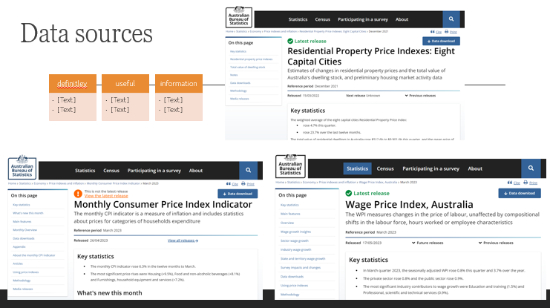

Slide 4
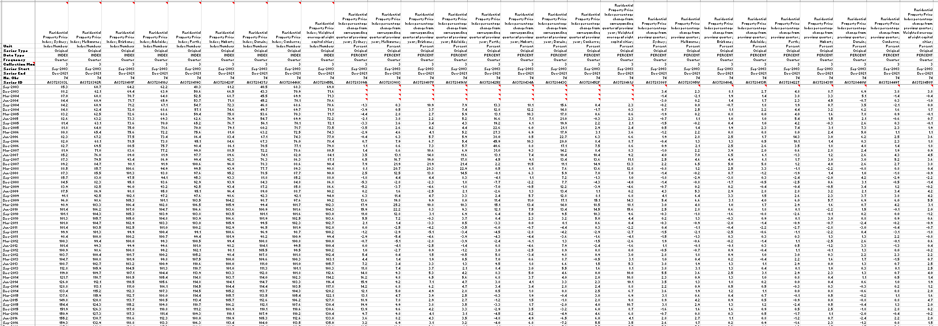
Large data set
Price index
% change from same quarter previous year
% change from previous quater

Slide 5
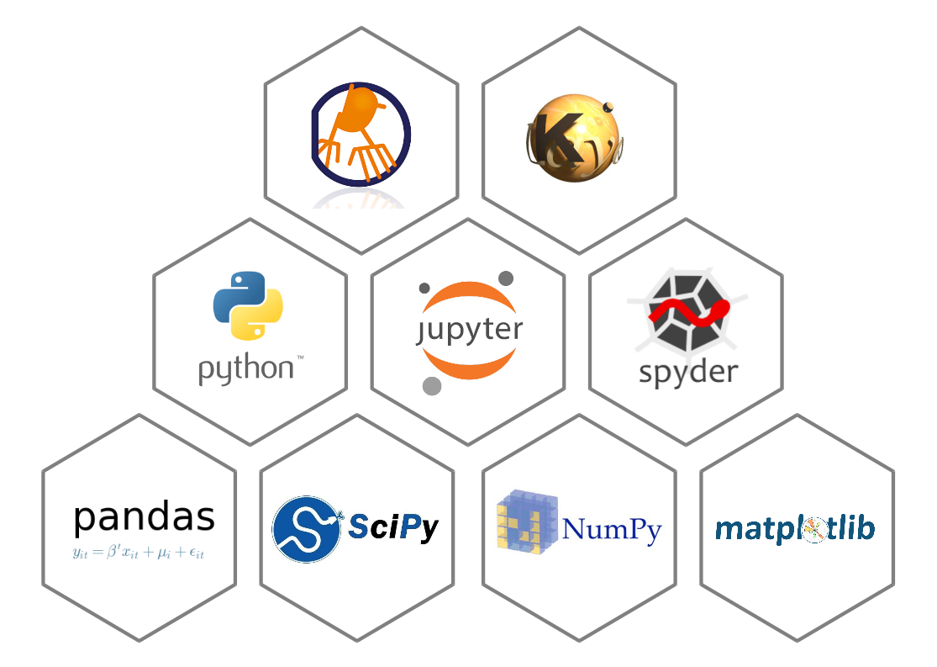


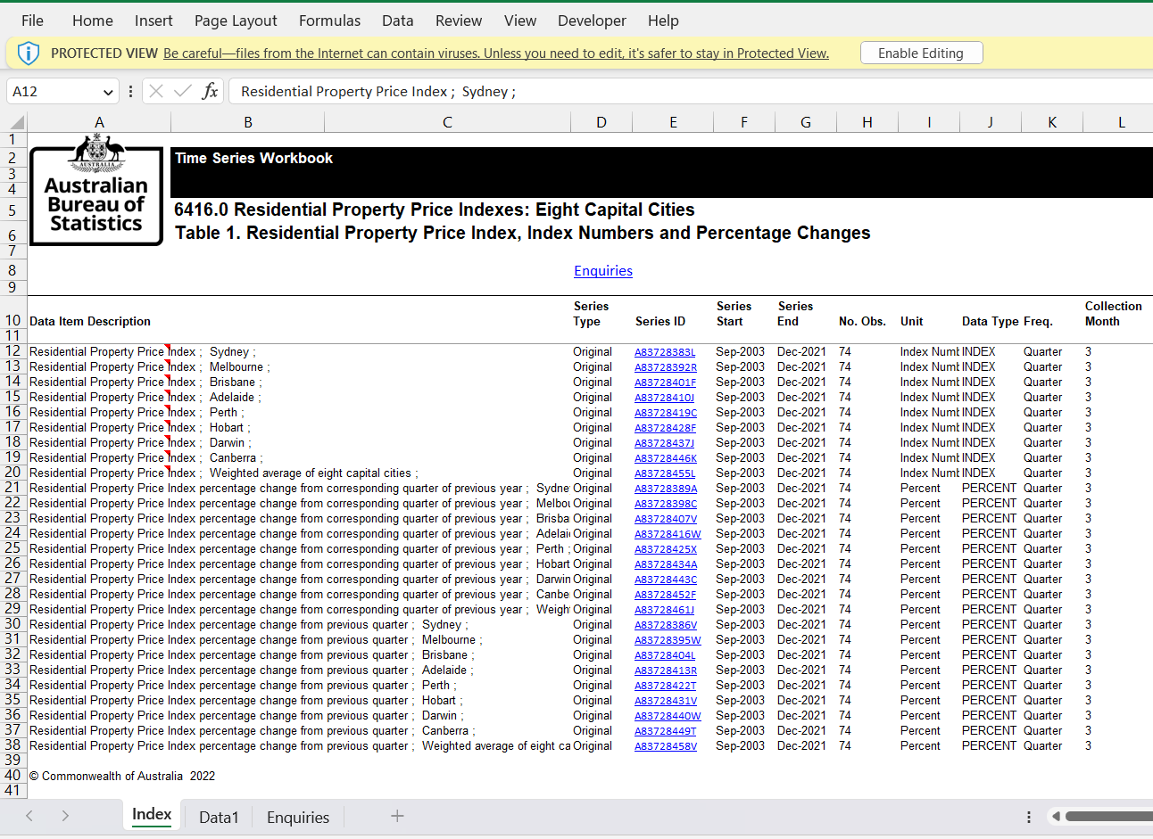

.CSV

Slide 6
WPI
The Wage Price Index measures changes in the price of labour, unaffected by compositional shifts in the labour force, hours worked or employee characteristics.
Key statistics
In March quarter 2023, the seasonally adjusted WPI rose 0.8% this quarter and 3.7% over the year.
The private sector rose 0.8% and the public sector rose 0.9%.

Slide 7
WPI
An increase in the size of average hourly wage change in both the private and public sector was the main driver of wage growth over the quarter.
Seasonally adjusted private sector wages rose 0.8% over the quarter. Annual growth lifted to 3.8%, from 3.6% in December quarter 2022. This is the highest annual growth recorded for the sector since June quarter 2012.
Public sector wages rose 0.9% over the quarter. Annual growth increased from 2.5% in the December quarter 2022, to 3.0% in the March quarter 2023. This is the highest annual growth since March quarter 2013.
(Tableau graph to demonstrate trend)

Slide 8
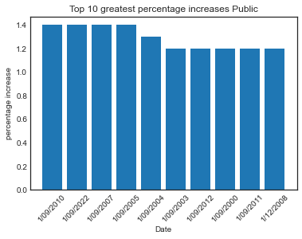
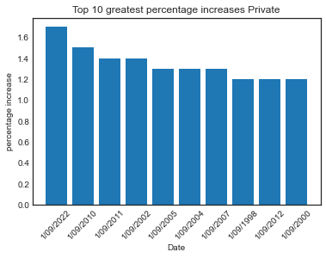
WPI ANALYSIS

Slide 9
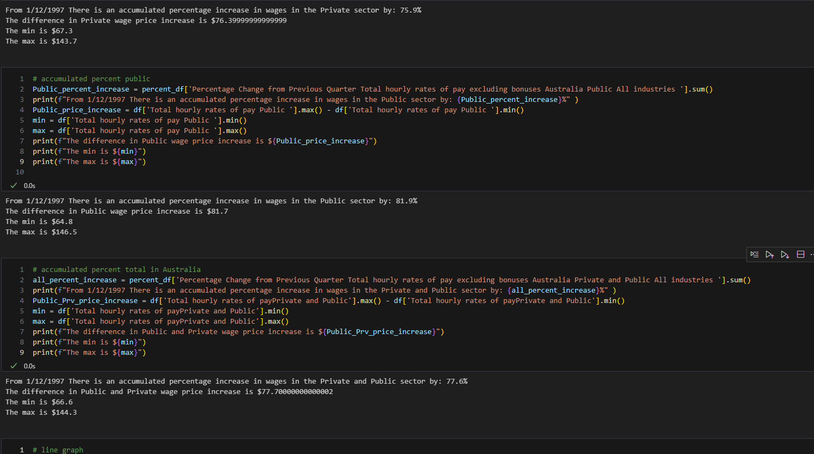
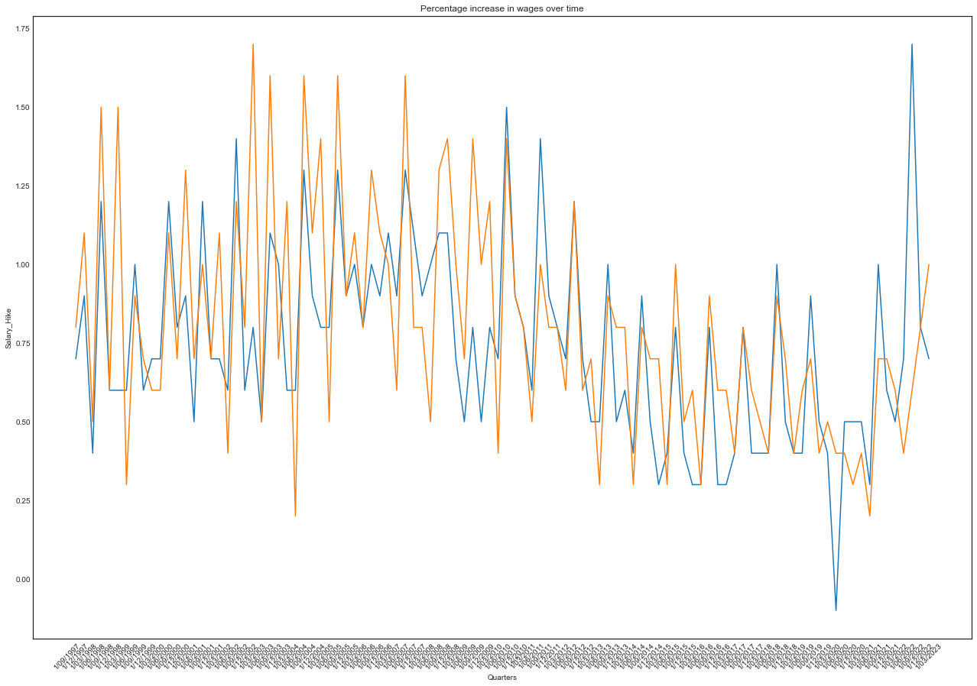
WPI ANALYSIS

Slide 10
CPI
The Consumer Price Index (CPI) measures household inflation and includes statistics about price change for categories of household expenditure.
- Over the last twelve months to the March 2023 quarter, the CPI rose 7.0%.

Slide 11
CPI
- Annual CPI inflation was 7.0 per cent in the March quarter, down from a 30 year high of 7.8 per cent in the December quarter. While prices continue to rise for most goods and services, these rises have moderated in the most recent quarter, resulting in lower annual inflation, than the previous quarter.
(Tableau graph to demonstrate trend)

Slide 12
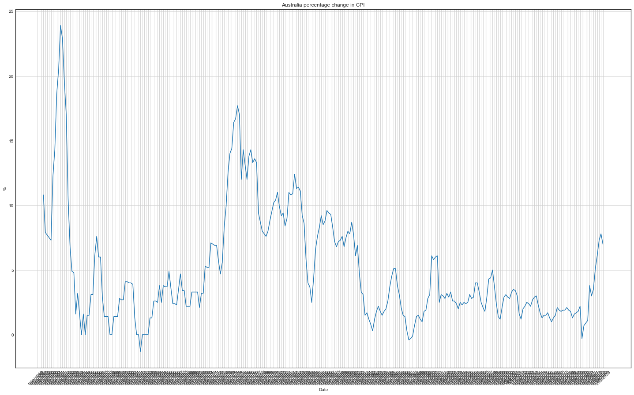
CPI

Slide 13
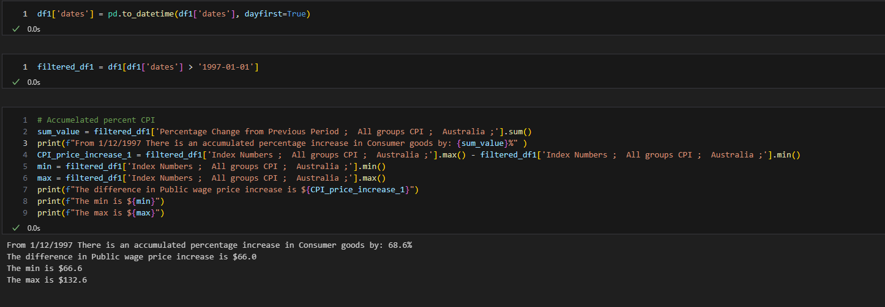
CPI

Slide 14
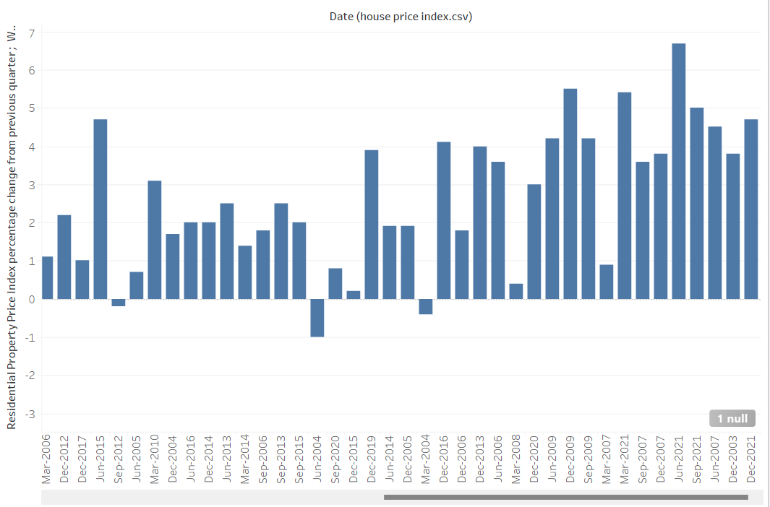
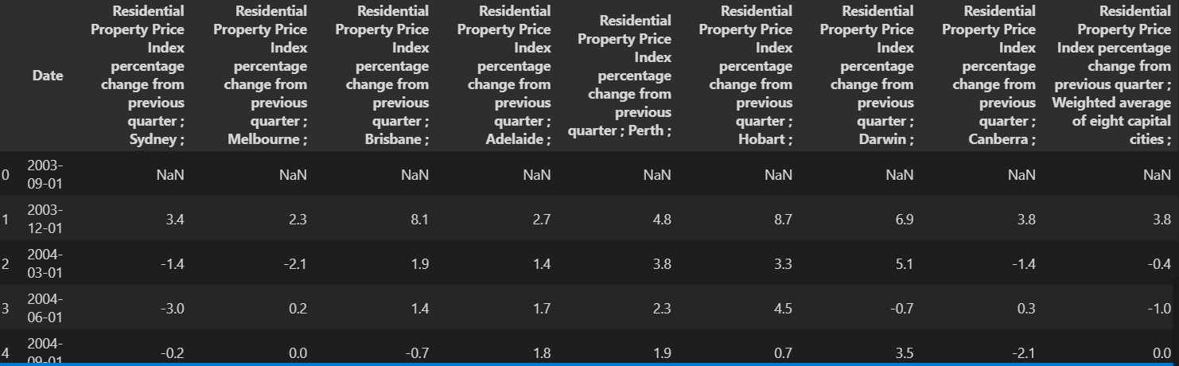
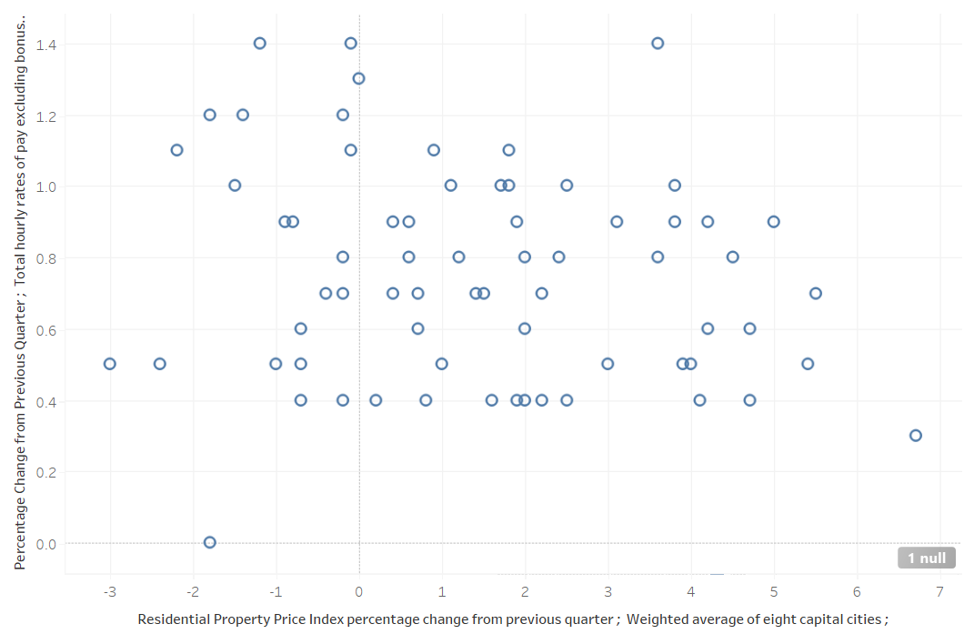
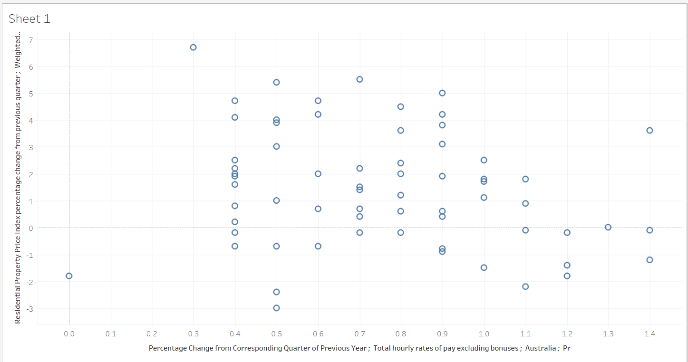
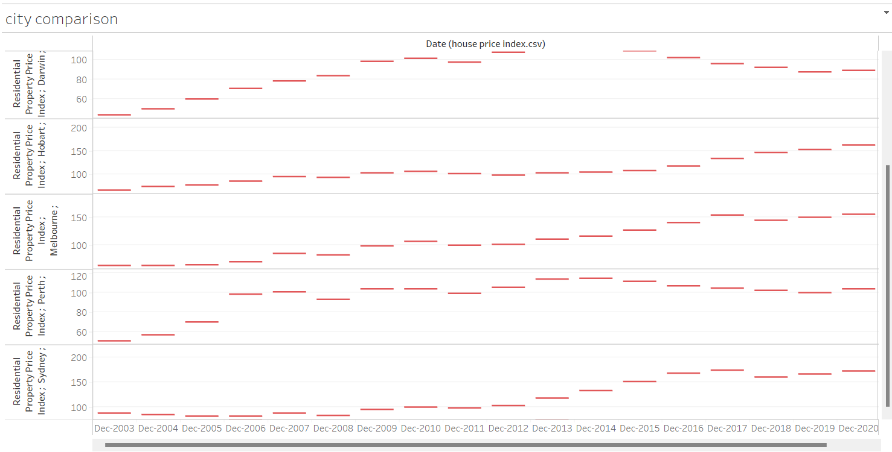
Resedential house price index
Chose to work with % increase data because house price numbers are complicated. quarterly data allows us to view seasonal trends.
Weighted average of % change for the eight capital cities

Slide 15
Machine learning WPI
- Tried to predict the future accuracy of predicting whether WPI will increase as time goes on.
- I failed to compare the model I made to another, however the particularly high F-1 score of 0.96. The model will correctly predict the percentage change 96% of the time. and will misclassify them as low risk ~4% of the time.

